Slide 1
How Important are Videos for Training Video LLMs?
Presenter: Kim Seung Hwan (seunghwan.kim@snu.ac.kr)

Slide 2
Paper
Lydakis, George, et al. "How Important are Videos for Training Video LLMs?." arXiv preprint arXiv:2506.06928 (2025).
CVPR ’25 Workshop Oral

Slide 3
Problem Setting
Video QA is a challenging and highly combined task
Understanding questions (language part)
Extracting various visual features (vision part)
Understanding the evolution of the features (temporal reasoning?)
Thus training the video LLM consists of three stages:
Train LLM (language part)
Train images (vision part)
Train videos

Slide 4
Problem Setting
“…to what extent are Video LLMs acquiring temporal reasoning capabilities from their video finetuning?”
Surprisingly, it is very small

Slide 5
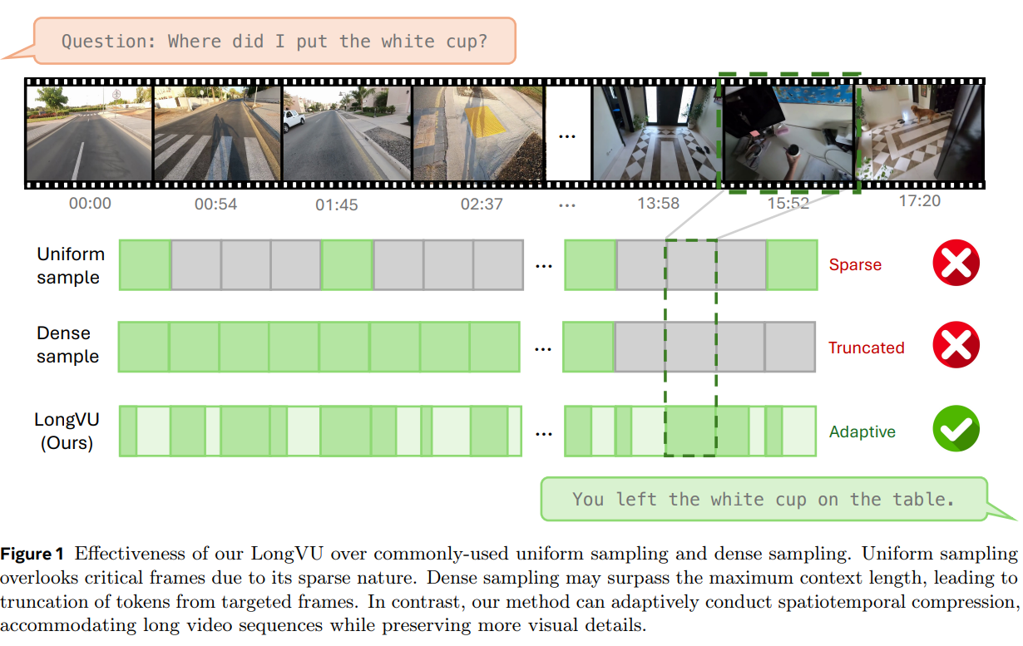
Baseline: LongVU
Utilizing DINOv2 feature similarity to select a subset of the frame

Slide 6
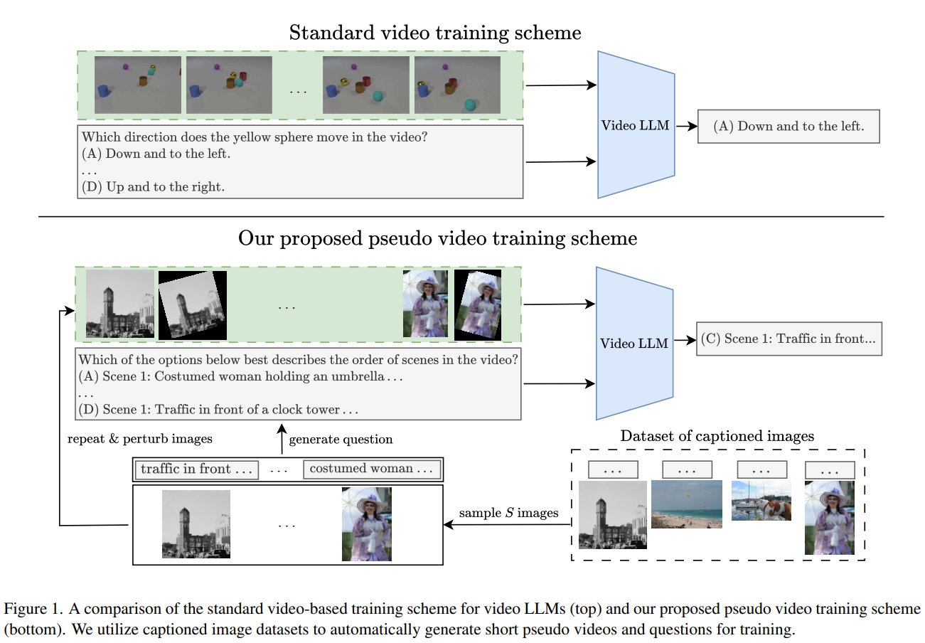
Pseudo Video

Slide 7
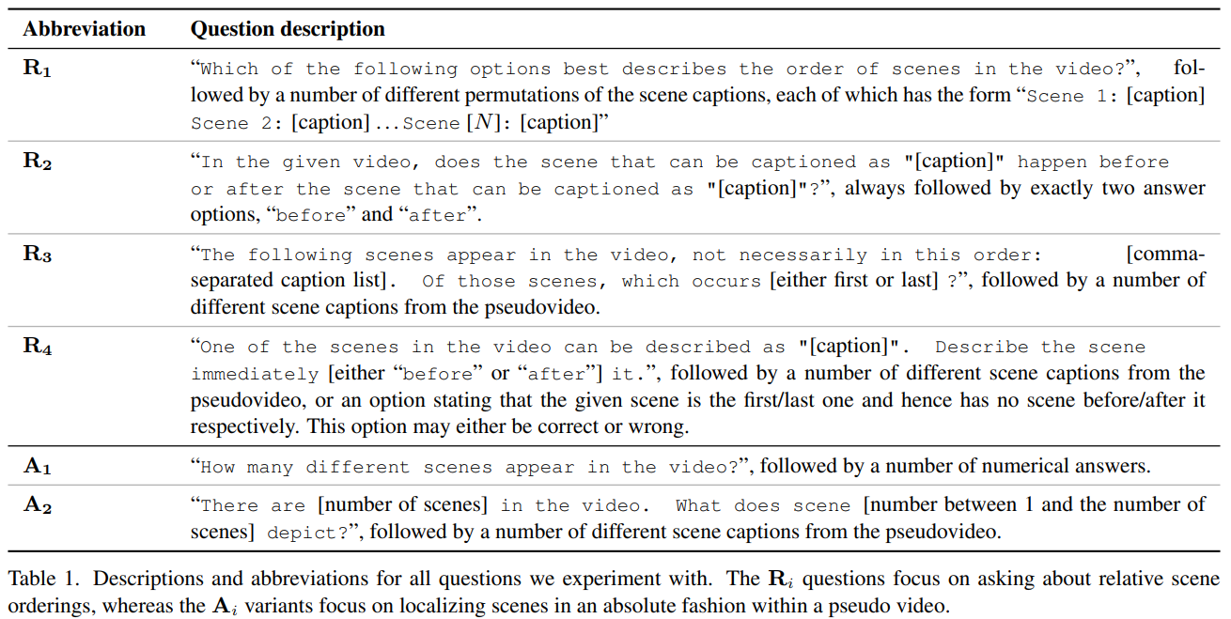
Pseudo Video

Slide 8
Pseudo Video
The pseudo videos are intentionally very information poor
The questions are very direct
The size is relatively small (100,000 vs 550,000)

Slide 9
Experiments
Comparison of fine-tuning between
Image-only
Image => Pseudo Video
Image => Real Video
Image => Real Video => Pseudo Video
Ablation of hyperparameters
TVBench as the benchmark, since it focuses on temporal reasoning

Slide 10
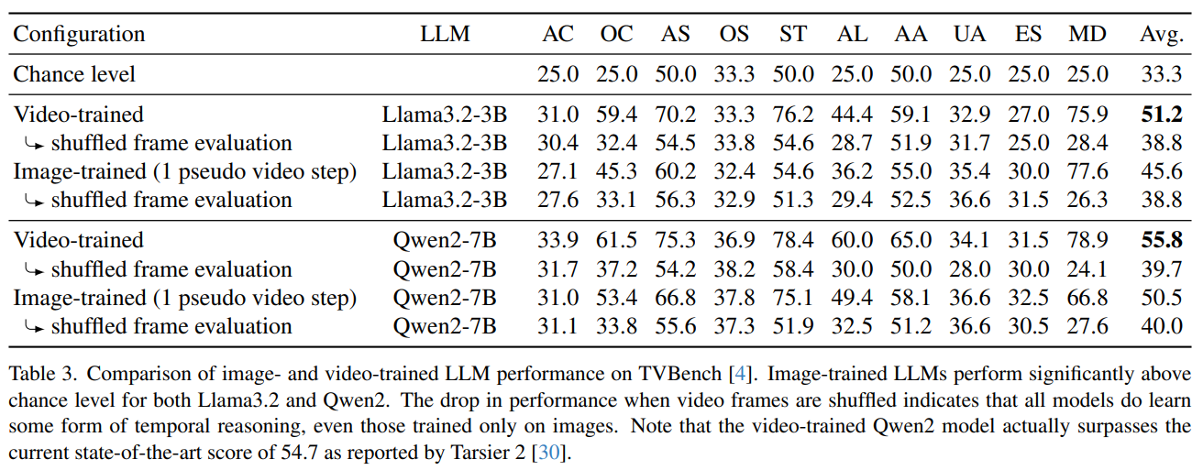
Image-only is close to Video

Slide 11
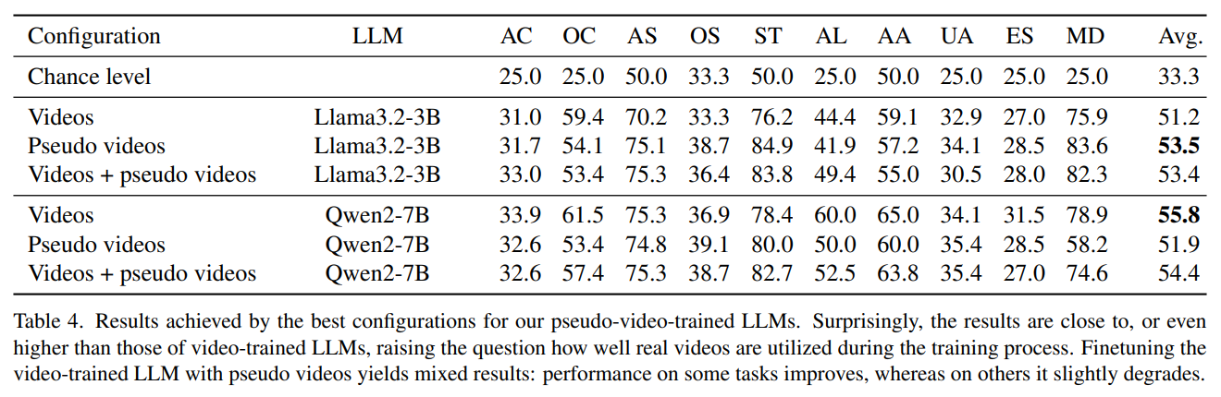
Rich data is NOT helping much
The data is of low quality,
And/or the architecture does not exploit rich data properly

Slide 12
Ablation Studies
The pseudo videos are so simple that we can lead to some intuition
It is not general and may be limited to this pseudo data!

Slide 13
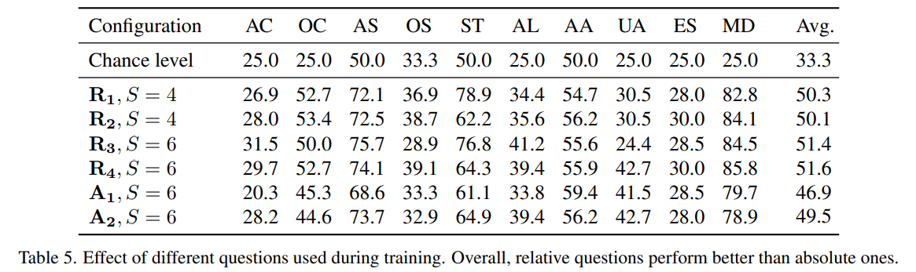
Ablation Studies

Slide 14
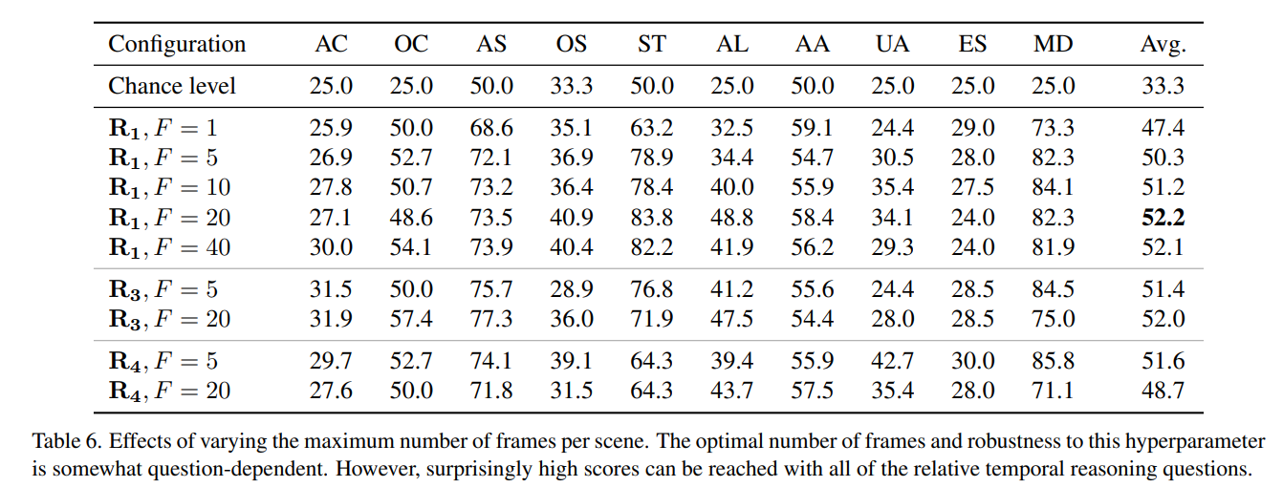
Ablation Studies

Slide 15
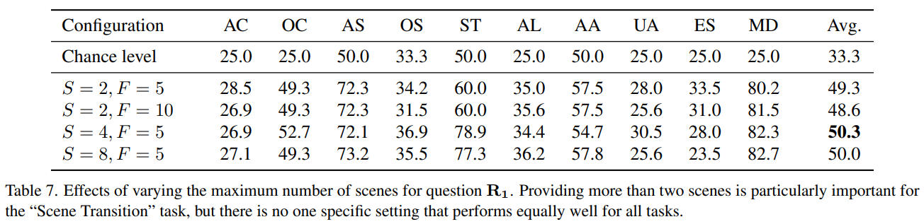
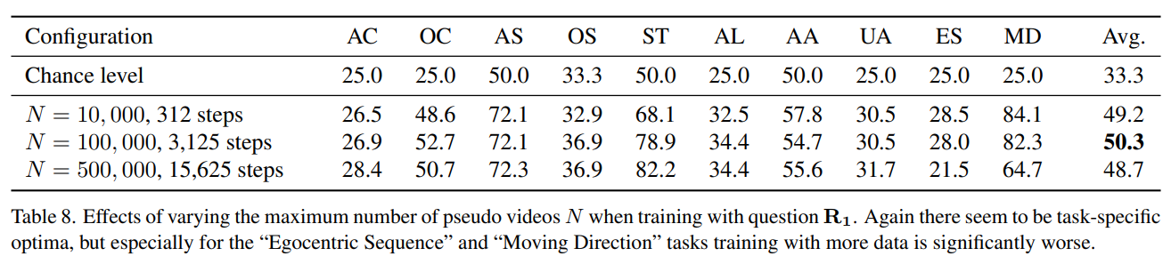
Ablation Studies

Slide 16
Takeaway
The model acquires considerable temporal reasoning ability w/o video
Currently, there are both data quality issue and architectural bottleneck
How can models achieve temporal reasoning capability using images alone?
What more can a model learn from rich videos that go beyond simple lists of images?
What is wrong with the current dataset?

Slide 17
Thank you for listening
Presenter: Kim Seung Hwan (seunghwan.kim@snu.ac.kr)

Slide 18
